Slide 1

Slide 1
Apps Project
by Emmett Keany
Facts, Findings, and Recommendations

Slide 2

Slide 5
PHASE I
Source
Load
The appropriate data sets were sourced from Kaggle, a reputable source of data
The data sets were loaded into VS Code in preparation for manipulation in the following phases of the project
1

Slide 3


Slide 5
PHASE II
Clean
Transform
The data sets were stripped of unnecessary, duplicate, or invalid data; data types were checked and repaired
The data sets had a ‘platform’ column added for identification purposes, and the data sets were joined for comparison
2

Slide 4

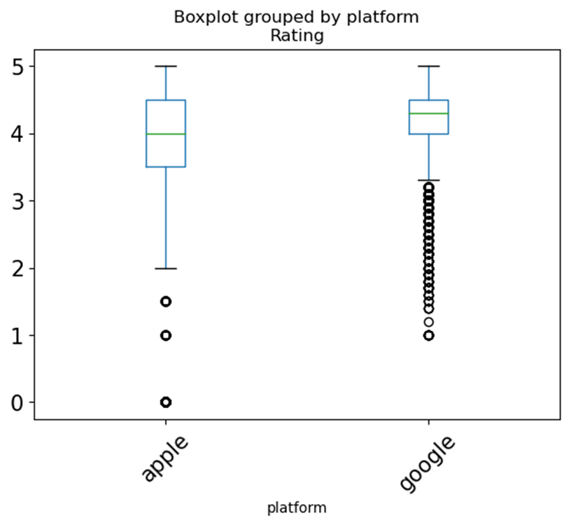
Slide 4
PHASE III
DATA VISUALIZED
Platforms Compared
3

Slide 5


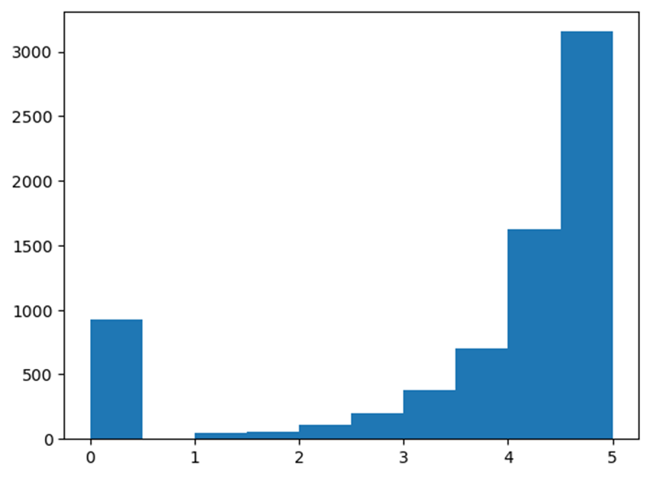
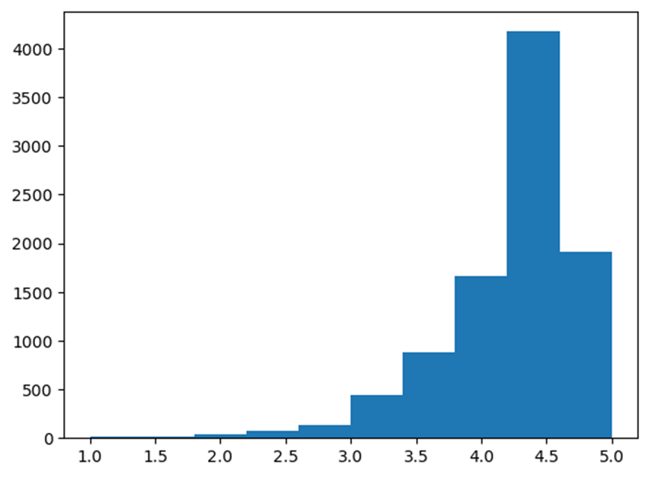
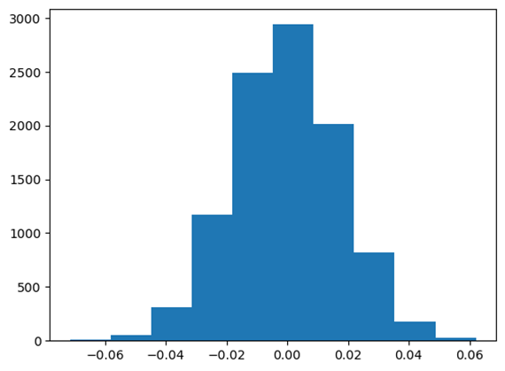
Slide 4
PHASE III
DATA VISUALIZED
Apple Histogram
Number of Users by Rating
Google Histogram
Number of Users by Rating
Google Histogram
Number of Users by Rating
Permutation Difference
4

Slide 6

Slide 10
Conclusion
The close mean user rating values initially observed would suggest little significant difference between the platforms. However, the permutation difference indicates a substantial difference of 0.6648 between the platforms. This difference shows Google Play Store to be the preferred platform for this venture.
5

Slide 7

Slide 11
THANK YOU

